Slide 1

ONLINE BANK MANAGEMENT SYSTEM
- Patel Kevin Anilbhai
- Chedella Siddhardha
- Kommu Revanth Kumar

Slide 2

Concept
Banking management system keeps track of and addresses the customer’s financial details.
The main aim here is to develop software for managing the bank account.
We develop the above using my SQL, HTML, and php.
We plan to create this software to make managing the customer and their account information easier and make strong security for all system information.
It also creates a report of all the banking operations.

Slide 3
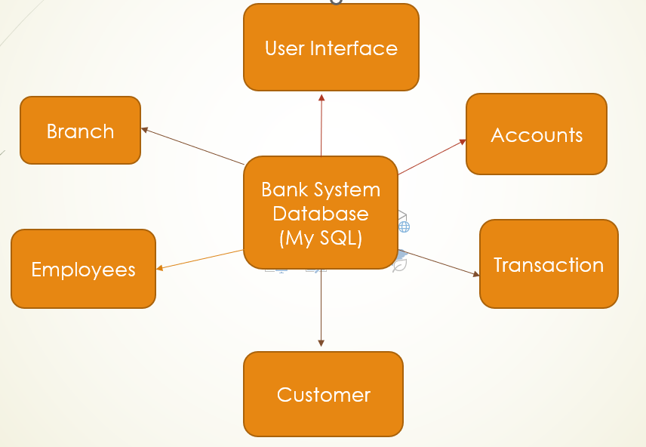

System Design

Slide 4
System entities
Bank
Branch
Employees
Customers
Accounts
Account Types
Transactions

Slide 5
Attributes for Entities
Bank :-
B_Name
B_Code (pk)
B_Location
Customer:-
Cust_Id
Fname
Lname
Cell_No
Email
City
DOB
Zip_Code
Branch :-
Name
ID (PK)
City
Zipcode
Account_Ids
Employees(Chasier) :-
E_Id (Pk)
F_Name
L_Name
City
Contact_Number
Email
Role_Id
B_Code (Fk)

Slide 6
Attributes for Entities
Account :-
Acc_No (Pk)
Name
Type
Date_opened
Status
B_Code (Fk)
Cust_Id (Fk)
Account_Type :-
Acc_Code
Acc_Type
Transactions :-
Tran_Id (Pk)
Acc_Id (Fk)
Cust_id
Withdrawl_Amt
DateTIme
Emp_Id

Slide 7
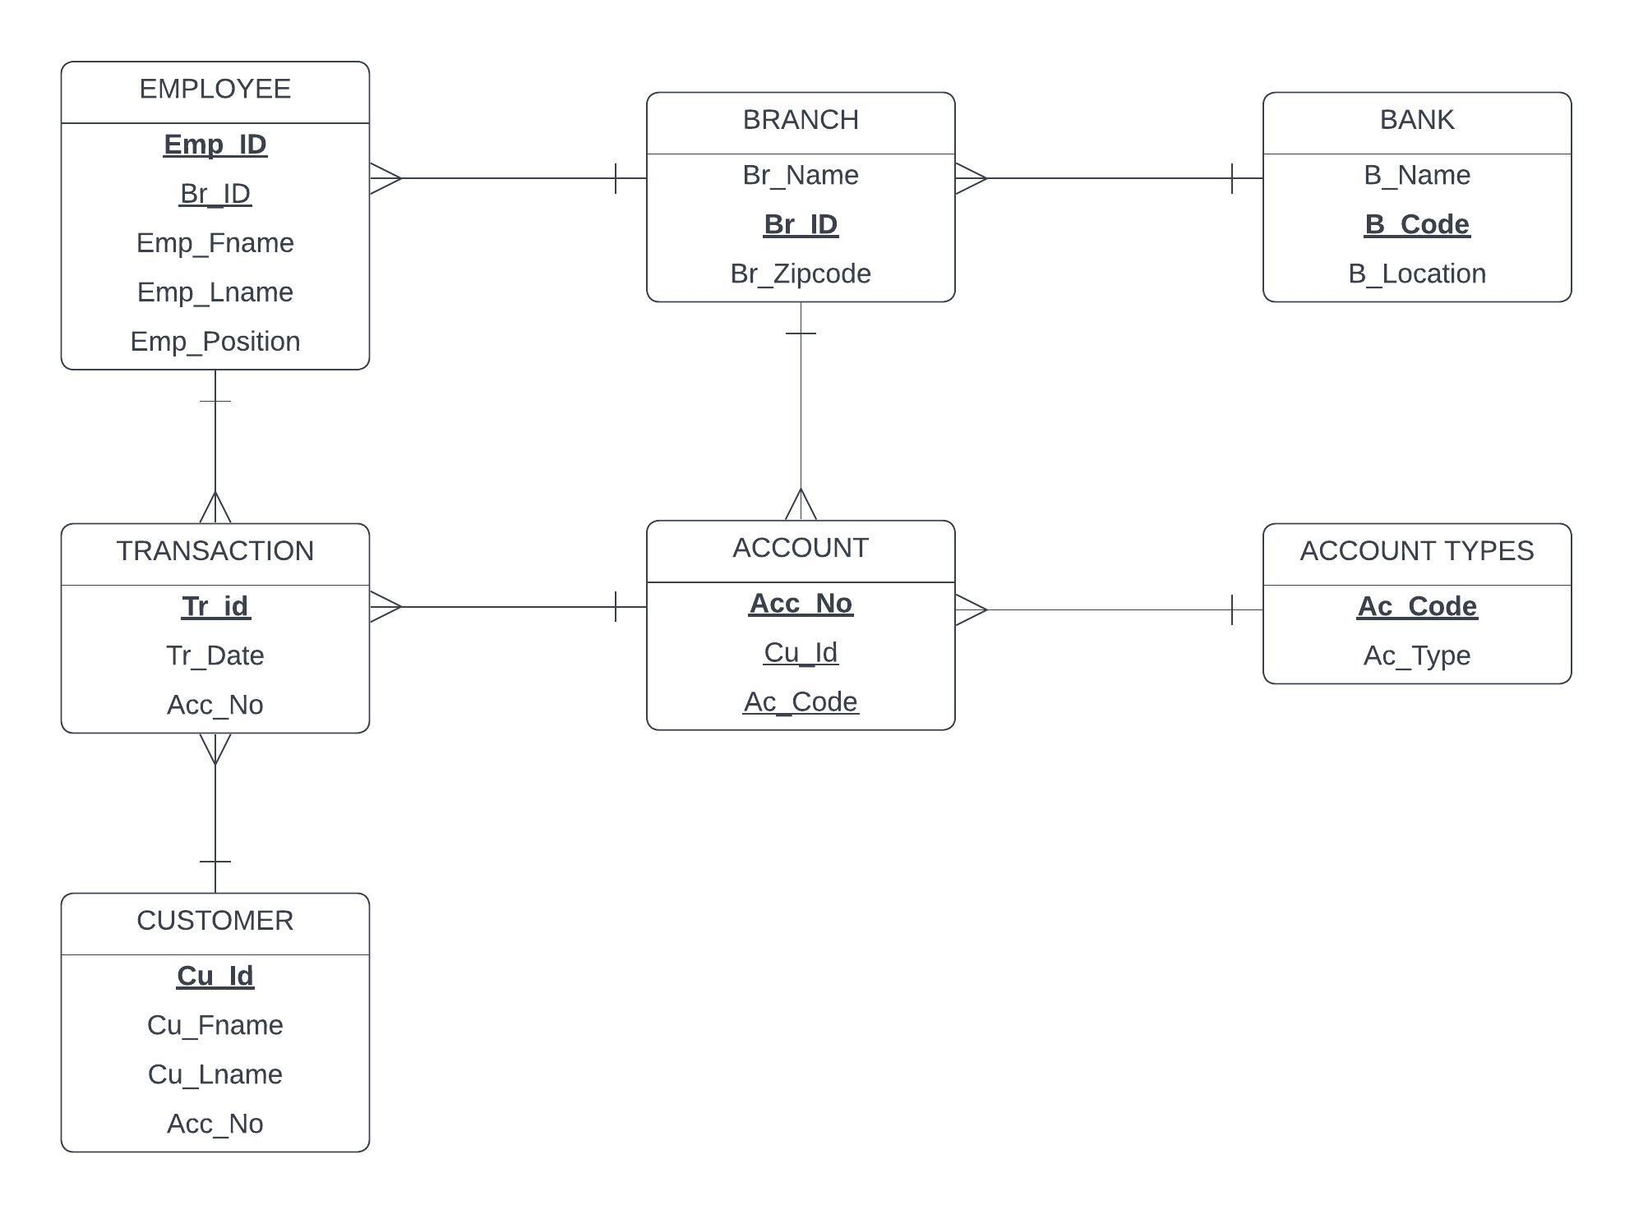
Entity relationship diagram(er)

Slide 8
Access controls
Admin :- Login
Create Users
Delete Users
Search Users
Edit User’s Information
Edit User’s Transaction
Employee :- Login
Update Details
Transaction – Credit And Debit
Customer :- Login
Edit Details
Balance Check
Transaction History

Slide 9
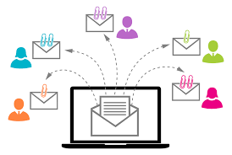


Security
User Authentication: Verify the identity of a user to provide access for the system. Manually giving access for the user to login into his account.
Securing Data: Store and Secure the of the users and administrators. Providing access to perform operations on the data
Send Notifications: Notify manager by sending text.

Slide 10
Security
Wrong Password Detection: If used a wrong password to login, will pop-up an error message on screen.
Manager Reports: Reporting the message given by the customer in the help section.

Slide 11
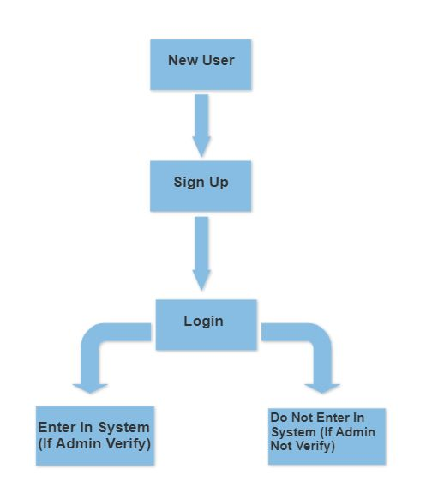
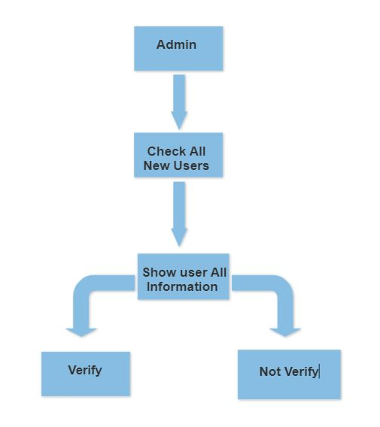
Are you a valid user?

Slide 12
Technologies Used
Database: MySQL
Front-End System: HTML
Back-End
System: PHP

Slide 13

Back End (Web Server) 1.Database
MySQL is a system that helps store and manage data efficiently. The database generally stores data in a structured fashion.
Open-Source
Quick and Reliable
Scalable
Data Types/Character Sets
Secure
Support for large databases

Slide 14
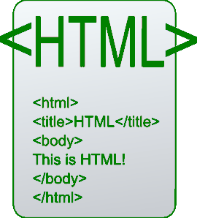
2.Html
HTML is the standard markup language for creating Web pages.
It is platform-independent.

Slide 15

Back End (Web Server)
PHP is a server scripting language and a powerful tool for making dynamic and interactive Web pages.
PHP can create, open, read, write, delete, and close files on the server.
PHP can collect form data.
PHP can send and receive cookies.
PHP can add, delete, and modify data in your database.
PHP can be used to control user access.
PHP can encrypt data

Slide 16
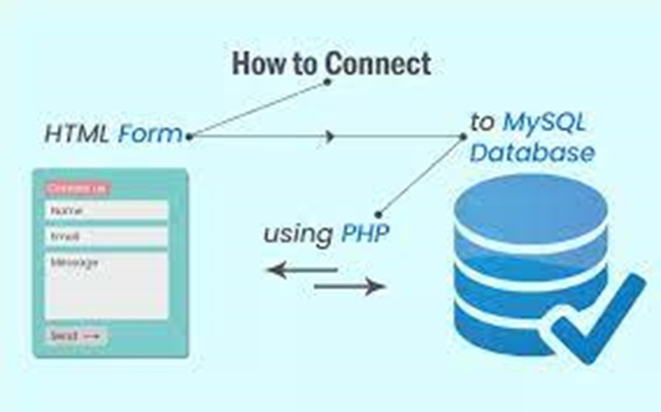

Slide 17
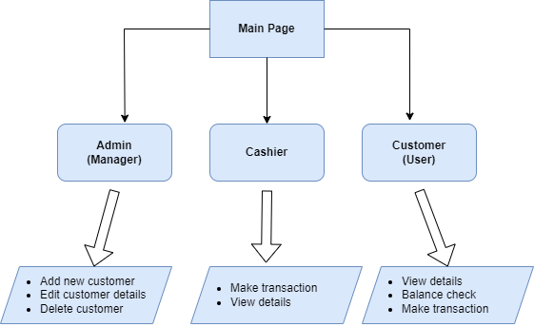
Interface

Slide 18
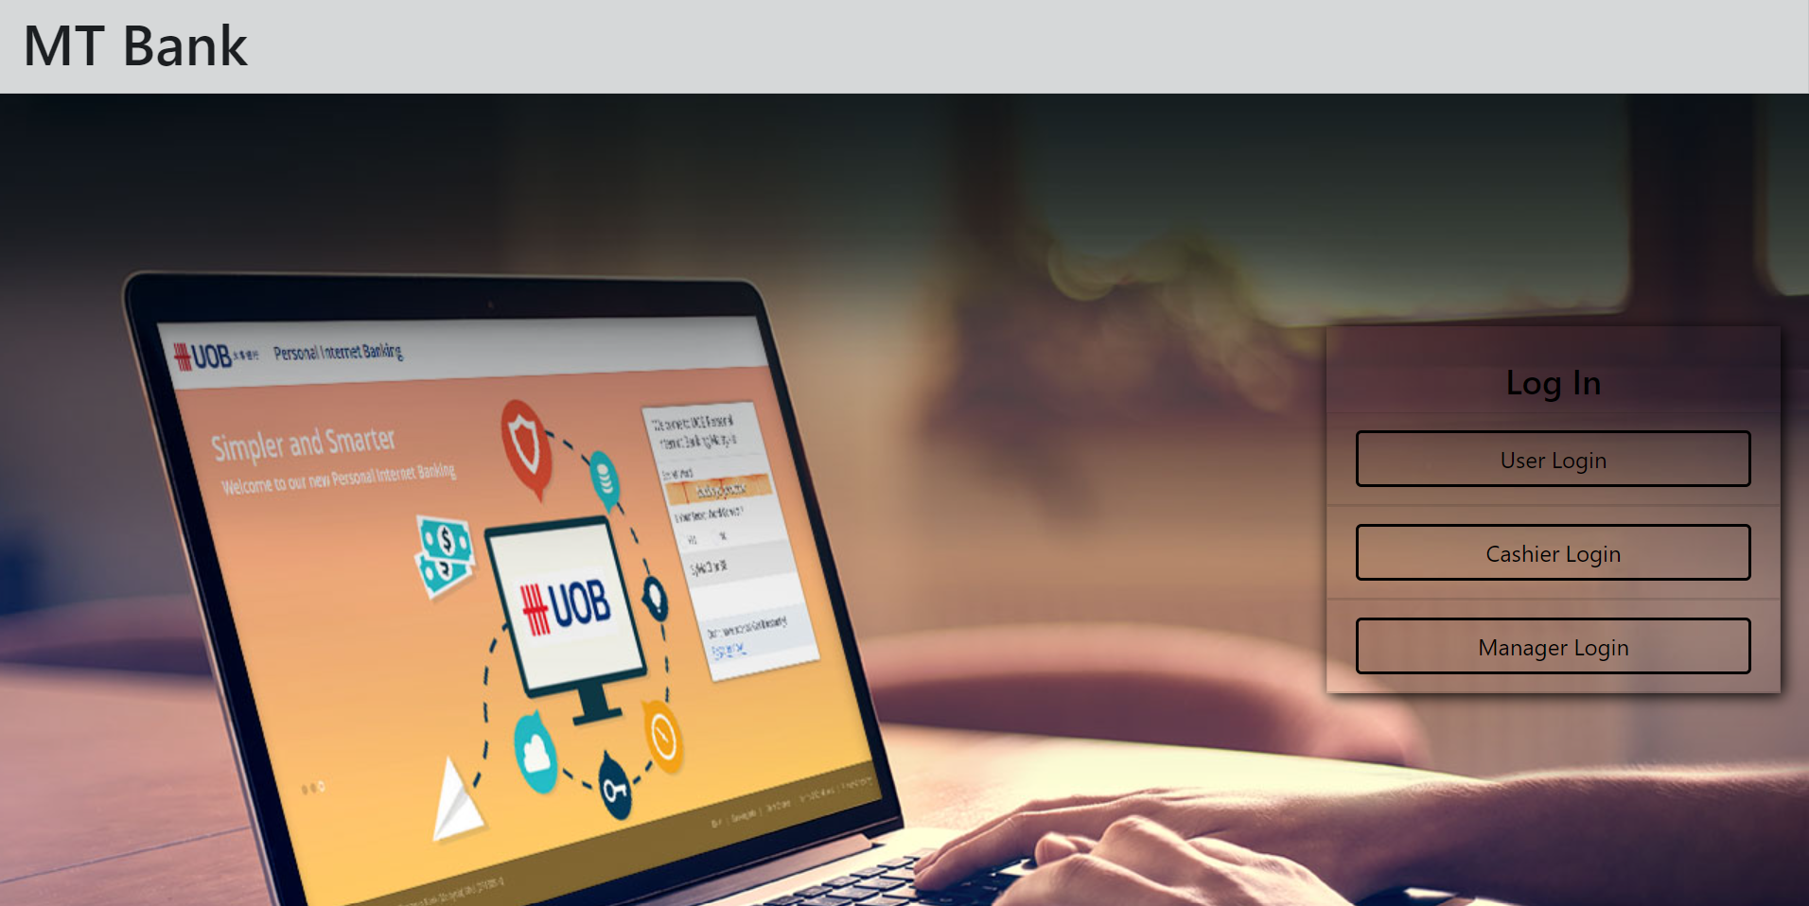
Home Page

Slide 19
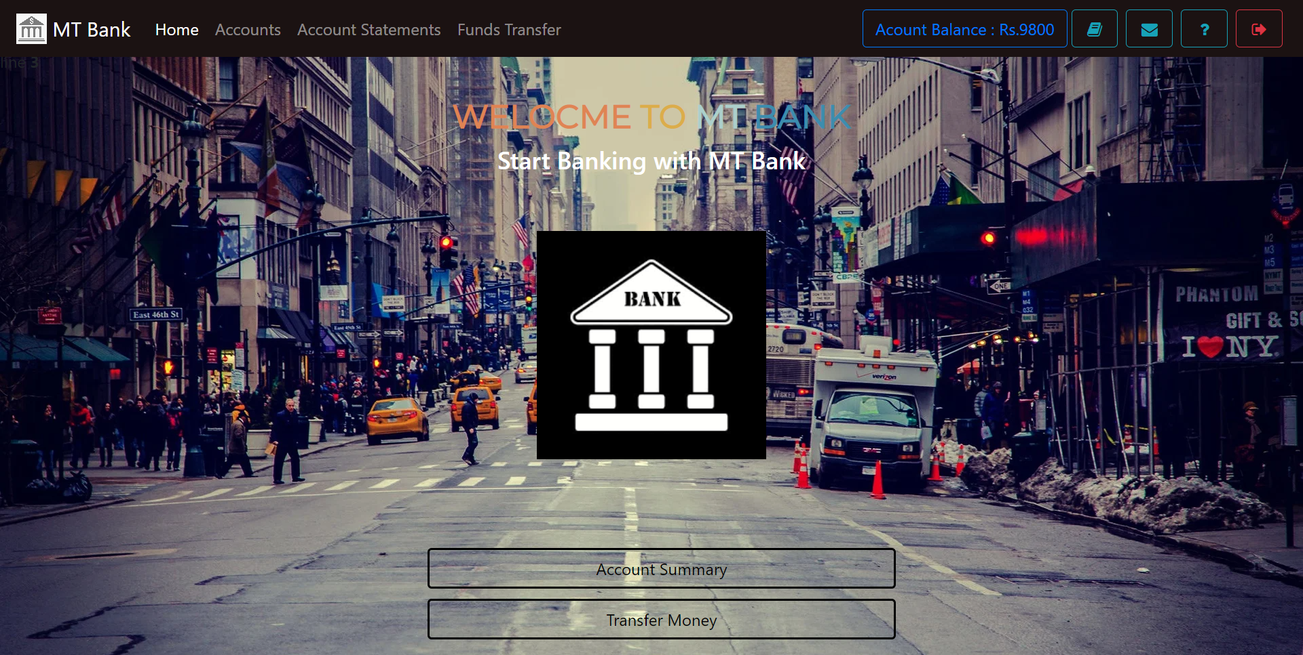
User View

Slide 20
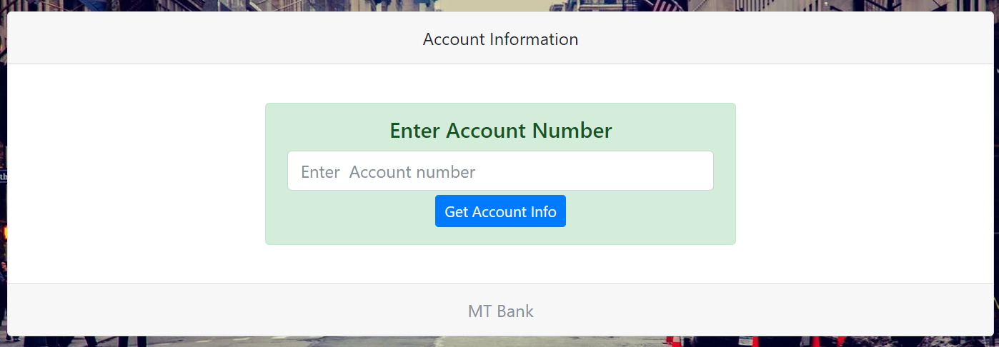
Cashier View

Slide 21
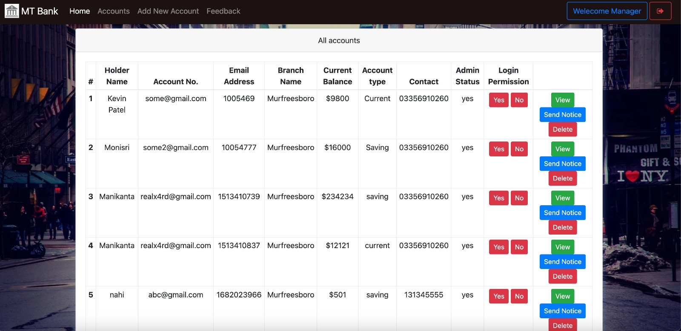

Slide 22

Thank You

